Slide 1
IRIS
Release Highlights
26.10

Slide 2
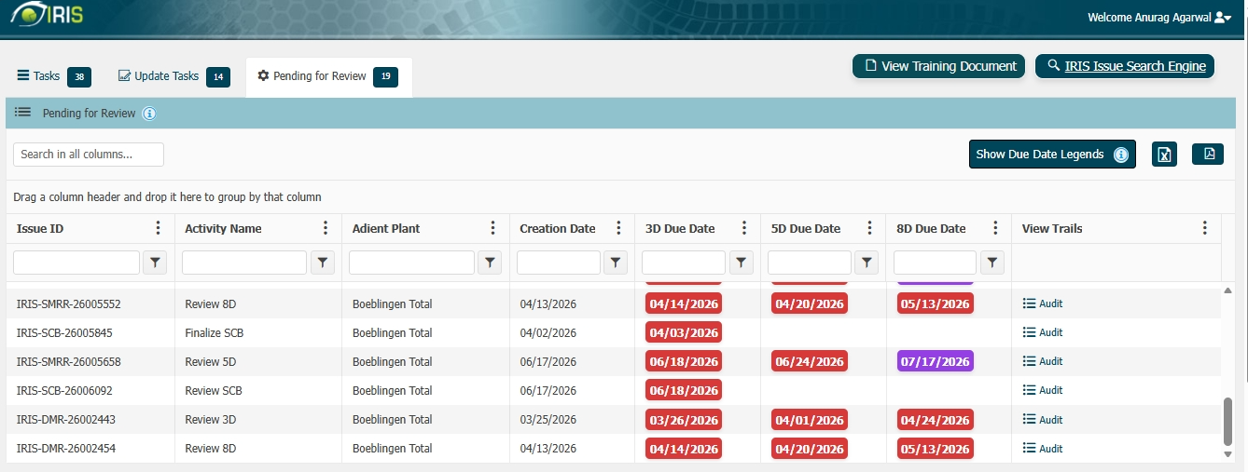
Display Review / Manage 3D, 5D, 8D and Chargeback tasks which are Pending for Review at Adient end to Supplier Users.
Problem Statement:
Supplier Portal users currently only have visibility of submit tasks. However, within the IRIS workflow, there are several tasks that are not accessible for suppliers to view. As a result, Supplier Portal users may assume that all tasks are completed, and no further action is pending.
Solution Applied :
To address this, a new functionality will be introduced that allows Supplier Portal users to see tasks pending on the Adient side for approval. These tasks will be view-only, with no action required from Supplier Portal users. Additionally, users will have read access to the associated audit logs for these tasks.

Slide 3
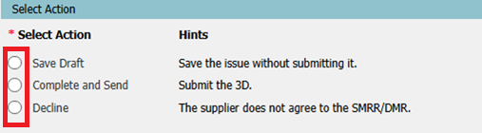
UI Enhancements | Add the border to all the radio buttons and checkboxes to make those more visible.
Problem Statement:
Supplier Portal users experienced difficulty identifying radio buttons and checkboxes on certain screens, particularly when working with complex forms, different display resolutions, or varying background colors. The lack of clear visual boundaries made selectable options less noticeable, increasing the risk of missed selections, incorrect inputs, and additional time spent reviewing forms before submission.
Solution Applied :
The Supplier Portal user interface has been enhanced by adding clearly visible and consistent borders to all radio buttons and checkboxes. The updated styling is applied across all states, including default, selected, hover, focus, and disabled states, ensuring users can easily identify available options regardless of screen resolution or page design.
Benefits:
Improved visibility of selectable controls throughout the Supplier Portal.
Reduced user errors caused by missed or unclear selections.
Consistent user experience across all Supplier Portal forms and workflows.

Slide 4
All Tasks Should Always Start from the "Issue Summary" Page
Problem Statement:
Users working on SMRR, DMR, and SCB tasks were not always presented with the Issue Summary section when opening a task. As a result, users could access task-specific sections without first reviewing the key issue details, leading to inefficiencies, inconsistent task execution, and a lack of immediate context regarding the issue being addressed.
Solution Applied:
The task navigation process has been standardized to ensure that all SMRR, DMR, and SCB tasks open with the Issue Summary page as the first screen. Users are now provided with a complete overview of the issue, including key details and context, before proceeding to subsequent sections such as root cause analysis, corrective actions, comments, or attachments. This creates a consistent and structured workflow across the application.
Business Benefits:
Provides a consistent user experience across all task types.
Ensures users review critical issue information before taking action.
Reduces the risk of missing important context or issue details.
Improves workflow standardization and process adherence.
Enhances user efficiency by establishing a clear and predictable task starting point.

Slide 5
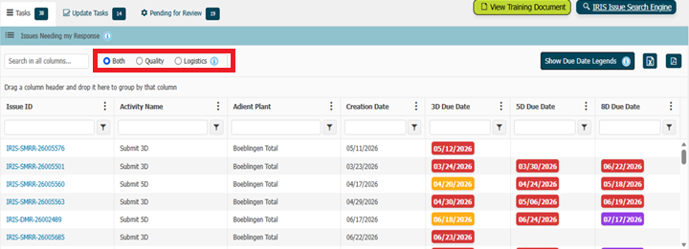
Dashboard | ToDo & Update Tasks | Filter Tasks by Quality / Logistics / Both
Problem Statement:
Supplier Portal users were presented with a combined list of Quality and Logistics tasks on the ToDo and Update Tasks page. As the number of open tasks increased, users found it difficult to quickly identify and focus on the tasks relevant to their responsibilities. This resulted in additional time spent reviewing task lists and increased the possibility of overlooking important actions that required attention.
Solution Applied:
New filtering options have been introduced on the Supplier Portal ToDo and Update Tasks page, allowing users to view Quality, Logistics, or Both categories. The task list now refreshes dynamically based on the selected filter, enabling users to quickly focus on the tasks most relevant to their role. When no tasks are available for a selected category, an informative message is displayed to provide clear user feedback.

Slide 6
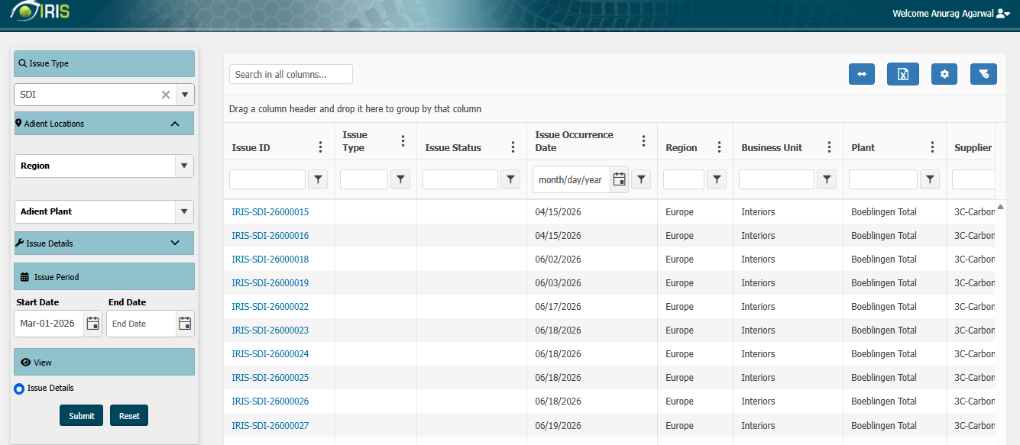
Search Engine | Implement Issue Type “SDI (Supplier Disruption Incident)”.
Problem Statement:
The Supplier Portal Search Engine did not include SDI (Supplier Disruption Incident) as an available Issue Type within the search criteria. As a result, users had limited visibility into disruption-related issues affecting their organization and were required to rely on alternative methods to locate relevant information. This made issue tracking less efficient and increased the time required to access critical incident details.
Solution Applied:
The Search Engine functionality has been enhanced to include SDI (Supplier Disruption Incident) as a supported Issue Type. Supplier users can now select SDI from the Issue Type filter and retrieve only those SDI records that are associated with their organization. This enhancement provides direct access to disruption-related issues through a familiar search experience, improving visibility and simplifying issue tracking and follow-up activities.

Slide 7
All Tasks | Save Draft Action | Make Comment Section Non-Mandatory.
Problem Statement:
Users working on SMRR and DMR tasks were required to enter comments before saving their work as a draft, even when they were not ready to provide additional information. This created an unnecessary dependency during the draft-saving process and limiting users' ability to save their progress quickly and return later to complete the task. As a result, users experienced interruptions in their workflow and reduced flexibility while managing incomplete tasks.
Solution Applied:
The Save Draft functionality has been enhanced to make the comment section optional when saving a task as a draft. Users can now save their progress without entering comments and return later to complete the remaining information. Existing validation requirements for submission and workflow completion remain unchanged, ensuring compliance with established business processes while providing greater flexibility during task preparation.
Business Benefits:
Allows users to save work in progress more efficiently without unnecessary data entry. Improves user productivity and flexibility when managing incomplete tasks. Reduces interruptions during task preparation and data collection activities.
Provides a more user-friendly and intuitive draft-saving experience. Maintains existing business controls for final submission while simplifying draft management.

Slide 8
Visual Enhancement | Background Data Processing | Display Loader for Each Background Data Processing
Problem Statement:
Several application activities involve background data processing that may take a few seconds to complete before information is displayed or updated. During these operations, users did not receive any visual indication that processing was in progress, making the application appear unresponsive. This created uncertainty about whether a request had been successfully initiated and often resulted in users repeatedly clicking buttons, refreshing pages, or navigating away before processing was complete.
Impact:
The application performed background data processing without providing a consistent visual status indicator to users. While the system was functioning correctly, the absence of a visible processing notification made it difficult for users to distinguish between normal processing time and a potential system issue. Additionally, user actions were not always restricted during processing, increasing the likelihood of duplicate requests and unintended system operations.
Solution Applied:
A standardized loading indicator has been introduced for all relevant background data processing activities across the application. Whenever a background operation is triggered, a loader is displayed immediately and remains visible until processing is completed. This enhancement provides users with clear feedback that the system is actively working on their request and helps prevent unnecessary repeated actions while processing is in progress.

Slide 9
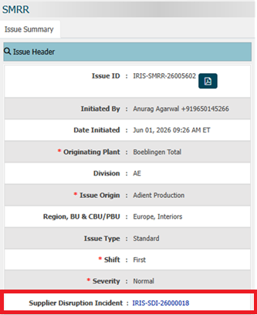
Search Engine | SMRR/DMR | Issue Summary | Related SDI Issue ID should be displayed.
Problem Statement:
Supplier Portal users could view SMRR and DMR issue details through the Search Engine; however, there was no visibility of any associated Supplier Disruption Incident (SDI) records within the Issue Summary. As a result, users were unable to easily identify whether a quality or logistics issue was linked to an SDI, requiring additional effort to locate related information through separate searches or communication channels. This reduced traceability and made it more difficult to understand the complete context of an issue.
Solution Applied:
The Supplier Portal Search Engine has been enhanced to display the Related SDI Issue ID within the Issue Summary section for applicable SMRR and DMR issues. The displayed SDI Issue ID is presented as an accessible reference and can be selected to open the corresponding SDI Summary page directly. This improvement provides users with immediate visibility of related disruption incidents and enables seamless navigation between associated records.

Slide 10
Submit 8D | Due Date is Auto-Filled in 7D Prevent Recurrence Section
Problem Statement:
During the Submit 8D process in the Supplier Portal, the Due Date field in the 7D – Prevent Recurrence section was being automatically populated with a date value. This prevented users from entering the appropriate due date based on their preventive action plan. The behavior created confusion and resulted in inaccurate milestone tracking for recurrence prevention activities.
Root Cause:
The Due Date field was configured with an auto-population logic that assigned a default/system-generated value when the 7D section was loaded. The existing field mapping and data-binding rules did not allow the field to remain blank for user entry. As a result, the system displayed a prefilled date regardless of the supplier's intended timeline.
Solution Applied:
The auto-fill logic associated with the 7D – Prevent Recurrence Due Date field was removed/updated to prevent automatic population. The field was configured to support manual user input and retain the selected value during save and submit actions. Validation and regression testing were performed to ensure correct Due Date behavior without impacting other 8D workflow sections.

Slide 11
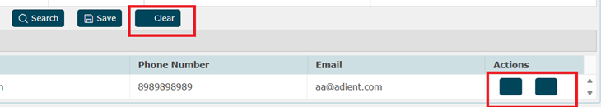
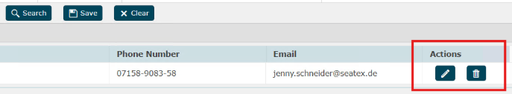
Actions buttons are not visible
Problem Statement:
Across multiple IRIS modules (SMRR, DMR), users reported that action buttons such as Save, Submit, Approve, and Reject were not visible on the screen. This prevented users from performing critical workflow activities and impacted daily business operations. The issue was observed after a browser upgrade rollout.
Root Cause:
A browser version upgrade introduced changes in rendering behavior and compatibility handling for certain UI components. Existing application scripts and style configurations were not fully compatible with the updated browser version, causing action buttons to be hidden or not rendered correctly. As a result, the affected modules were unable to display workflow action controls to users.
Solution Applied:
The affected UI components, styles, and scripts were reviewed and updated to ensure compatibility with the upgraded browser version. Necessary code changes were implemented to correctly render action buttons across all impacted modules. Comprehensive validation and regression testing were performed to confirm that action buttons are displayed consistently and all workflow actions function as expected.

Slide 12
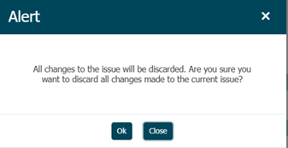
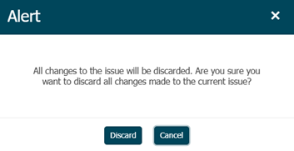
Update 3D | Exit popup will have Discard and Cancel buttons instead of OK and Close buttons
Problem Statement:
In the Supplier Portal – Update 3D screen, the exit confirmation popup displayed "OK" and "Close" buttons when users attempted to leave the page with unsaved changes. This button labeling was inconsistent with the standard user experience followed across other application modules. The inconsistency caused confusion among users regarding whether their changes would be saved, discarded, or retained.
Root Cause:
The exit confirmation dialog in the Update 3D functionality was implemented using a different button configuration than the standardized popup used across the application. As a result, the popup displayed "OK" and "Close" instead of the approved "Discard" and "Cancel" options. The lack of alignment with enterprise UI standards led to an inconsistent user experience.
Solution Applied:
The exit confirmation popup was updated to replace the "OK" and "Close" buttons with "Discard" and "Cancel" buttons, in accordance with the application's standard design guidelines. The functionality was validated to ensure Discard exits the screen without saving changes, while Cancel retains the user on the current page. Regression testing was performed to confirm consistency of exit popup behavior across the system.

Slide 13
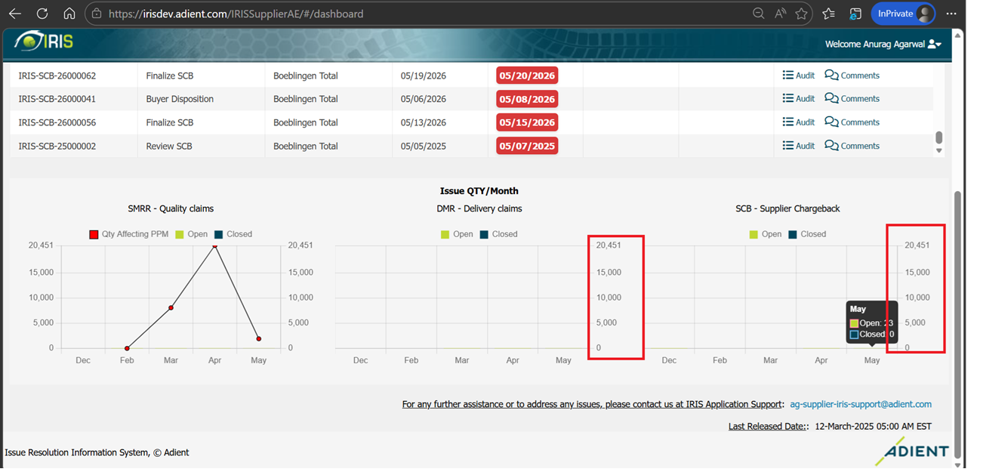
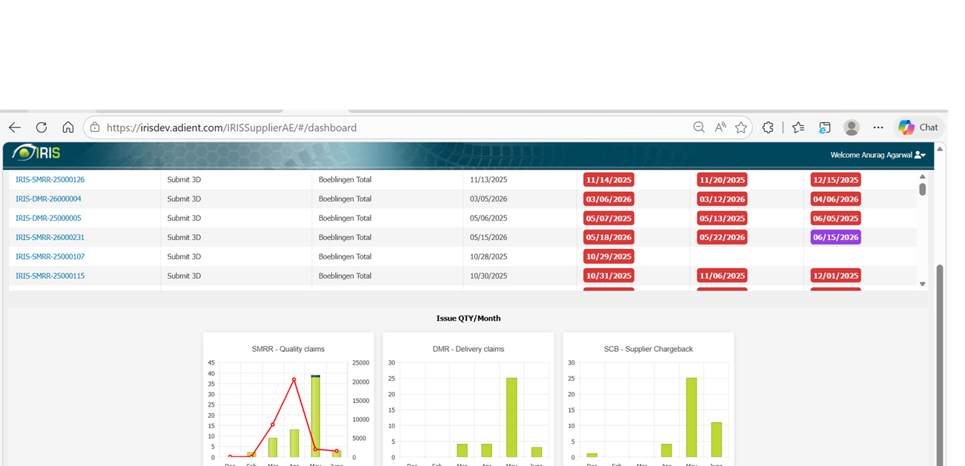
Dashboard | DMR and SCB Graphs were not getting displayed properly.
Problem Statement:
In the Supplier Portal, the DMR and SCB dashboard graphs were displaying incorrect data counts, resulting in inaccurate visualization of supplier quality metrics. Users observed discrepancies between the graph values and the actual records available in the system. This impacted reporting accuracy and reduced confidence in dashboard-based decision-making.
Root Cause:
The issue was caused by incorrect data aggregation and filtering logic used to populate the DMR and SCB dashboard graphs. Certain records were either excluded or counted improperly during data retrieval and calculation processes. As a result, the graphs displayed counts that did not accurately reflect the underlying transactional data.
Solution Applied:
The graph data calculation and aggregation logic were reviewed and corrected to ensure accurate retrieval and counting of DMR and SCB records. Necessary code changes were implemented to align the dashboard counts with the actual data stored in the system. Validation and reconciliation testing were performed to confirm that graph values match the corresponding source records and reports.

Slide 14
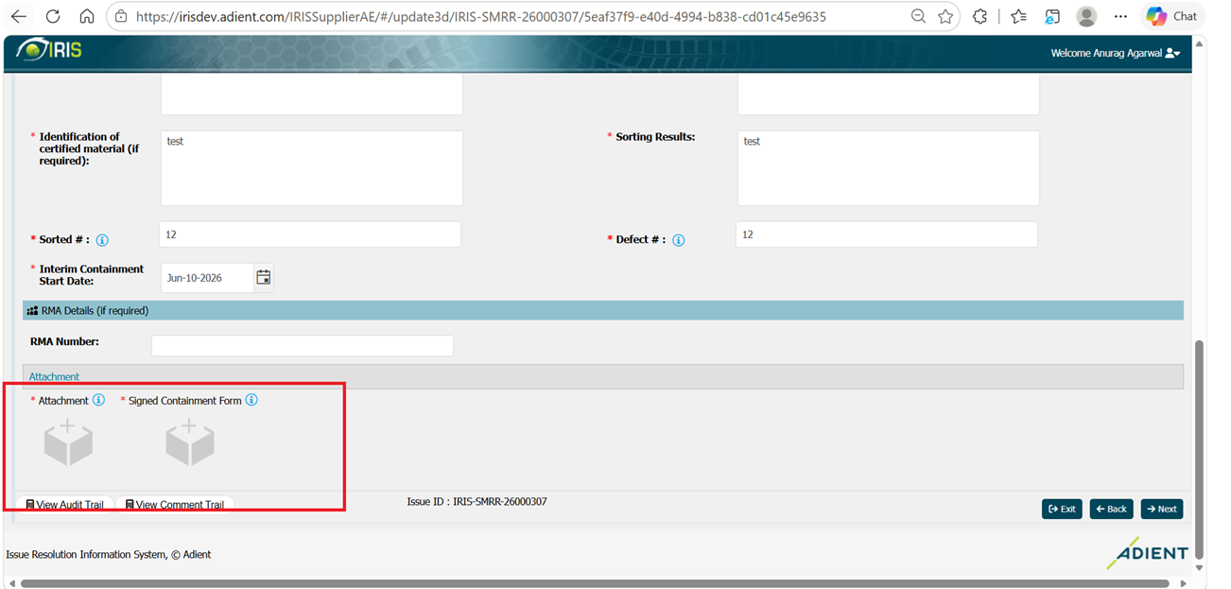
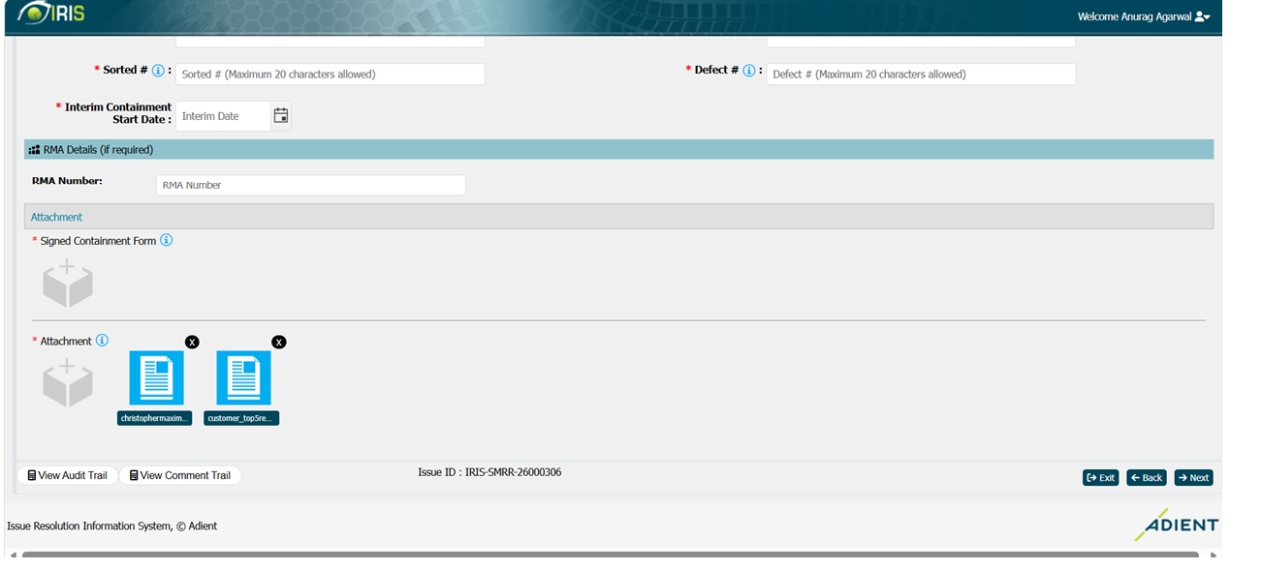
Update 3D | There was no separation between Attachment and Signed containment form section.
Problem Statement:
In the Supplier Portal – Update 3D screen, the Attachment section and Signed Containment Form section were displayed without proper visual separation. The layout caused both sections to appear merged, making it difficult for users to distinguish between supporting attachments and signed containment documents. This resulted in a confusing user interface and reduced usability during 3D updates.
Root Cause:
The issue was caused by a UI layout defect in which the Attachment and Signed Containment Form sections were not configured with the appropriate alignment and spacing. Both sections were rendered in a way that lacked clear visual distinction, causing them to appear as a single block of information.
Solution Applied:
The screen layout was updated to display the Attachment and Signed Containment Form sections vertically with proper spacing and section separation. UI enhancements were implemented to improve readability and clearly differentiate the two document areas. Validation testing was completed to ensure the updated layout is displayed consistently across supported browsers and provides an improved user experience.

Slide 15
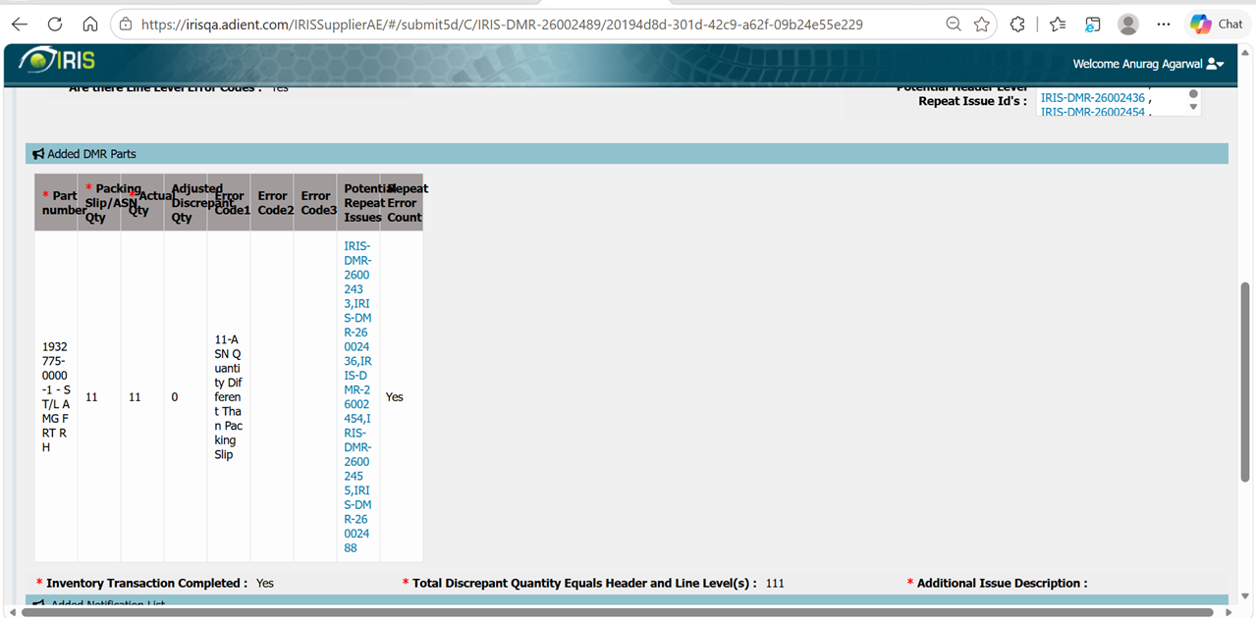
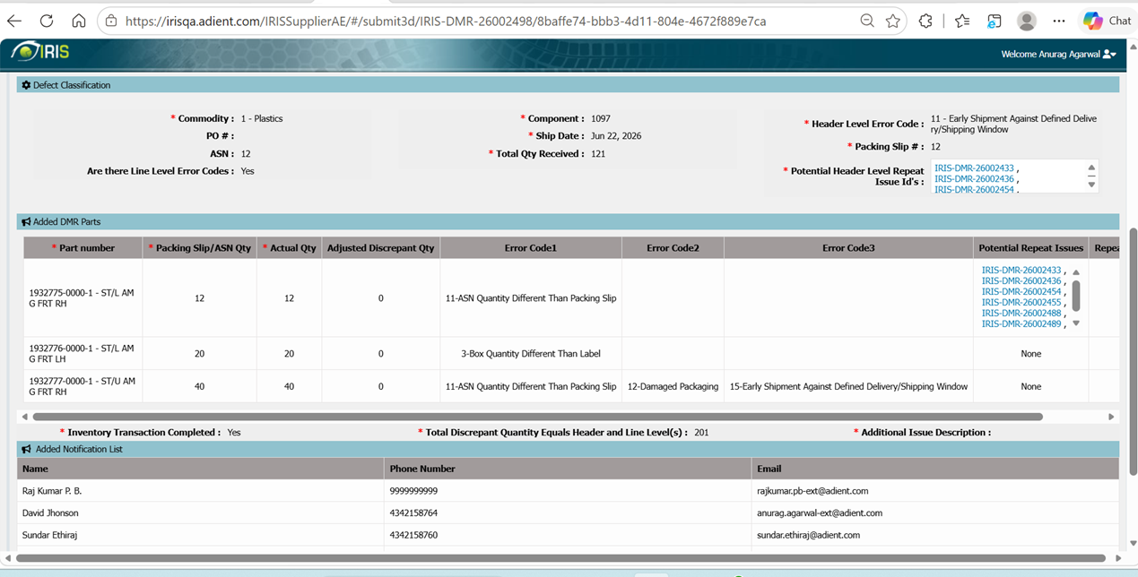
Submit 3D | Data is not aligned in Added DMR Parts of Issue summary page.
Problem Statement:
In the Supplier Portal – Submit 3D process, data displayed under the Added DMR Parts section on the Issue Summary page was not properly aligned. Information appeared mis-formatted, making it difficult for users to review part details accurately before submission. The inconsistent presentation affected readability and overall user experience.
Root Cause:
The issue was caused by a UI formatting and alignment defect in the Added DMR Parts section. The screen rendering logic did not correctly align data fields and values when displaying DMR part information on the Issue Summary page. As a result, records appeared misaligned and were not presented in a structured format.
Solution Applied:
The Issue Summary page layout was reviewed and updated to ensure proper alignment of all fields within the Added DMR Parts section. UI formatting and display logic were corrected to present the data in a clear, consistent, and readable manner. Validation and regression testing were performed to confirm accurate alignment across different data scenarios and supported browsers.

Slide 16
Thank You

